Slide 1
Information Architecture Session #05
Course : GAME6012/ User Experiences
Effective Period : September 2017

Slide 2
Learning Objectives

Slide 3
Information Architecture
One of the often overlooked and undervalued skills of the UX practitioner is Information Architecture, or IA. IA is to content and functionality what wireframes are to visual design. IA is the skeleton that informs visual design and dictates what information the user will see and interact with. IA is how information is organized and prioritized, and IA helps customers/users navigate through their experience.

Slide 4
What is IA?
"Information architecture (IA) is the structural design of shared information environments; the art and science of organizing and labeling websites, intranets, online communities and software to support usability and findability; and an emerging community of practice focused on bringing principles of design and architecture to the digital landscape."

Slide 5
The Four Cs of IA
Coordination
Cooperation
Change
Consuequence
When you first enter a supermarket, at least in the U.S., you will often encounter sights, sounds, and smells designed to grab your attention and keep you engaged for the duration of your shopping experience. We will use supermarket as an example to understand more about this concept

Slide 6
Coordination
The supermarket experience presents thousands of products and choices coordinated in a way that allows customers/users to process it all very quickly. Without this coordination, it's possible to become overwhelmed and confused about what to do first. Therefore, coordinating information allows for a clear starting and end point as well as guidance along the way. Think of IA as an ecosystem of information, where one piece of information connects to another using visual cues, sights, sounds, content, navigation, and so on, providing the customer/user with a kind of sensory map that guides them successfully to their ultimate destination.

Slide 7
Coordination
Other example

Slide 8
Cooperation
As we make our way through the shopping experience, we will come across many distractions. Distractions are a normal part of the IA experience and are not only unavoidable, but we actually seek them out!
How easily and quickly we can recover from these distractions and still reach our ultimate goal will determine how cooperative the IA we are interacting with really is.

Slide 9
Change
Good IA is designed to move customer/users through an experience quickly and efficiently. It also allows for change to occur without the need for refactoring the underlying structure of the design. Returning to the supermarket example, this could mean different products being showcased, new items being added to the shelves, and so on. The IA doesn’t change though because its the underlying framework, providing the means for change to take place seamlessly. Similar IA exists online as well, with websites such as Amazon, Facebook, and CNN, where content changes quickly, although the experience stays the same.

Slide 10
Consequence
The last of the four Cs is "consequence," meaning user outcomes versus user experience versus outlay of time and resources to reach the intended goal. For a business stakeholder, the consequences are measurable improvements, profits, return on investment (ROI), new customers, higher customer satisfaction ratings, and so on. For a customer/ user, it might mean a quick and painless interaction or an enjoyable one where the information and objectives they sought were met appropriately and to their expectations.

Slide 11
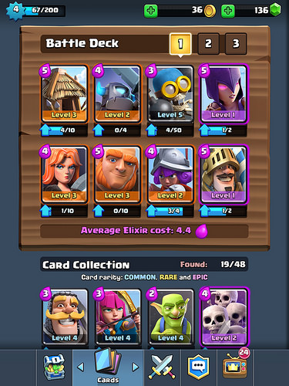
How are we use it on game?
Coordination
The information presented are separated into 5 related parts that is cohesive with one another
Cooperation
All information are working together, the data how much card needed to upgrade, etc.
Change
Information updated while sliding left and right
Consequences
The IAP implementation is engaging

Slide 12
Assignment
Search a game on playstore
Measeur their 4C’s

Slide 13
References
Buxton, William. 2007. Sketching user experience. Elsevier
Anderson, Stephen. 2011. Seductive Interaction Design. New Riders.
Faranello, Scott. 2016. Practical UX Design. Packt Publishing

